Slide 1
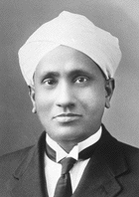
C V Raman
Life and Times
1-March-2010
Borrowed from Wiki, Raman’s papers and Ramaseshan’s lectures on Raman

Slide 2
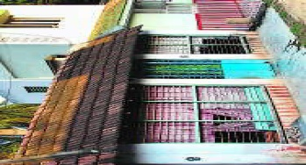
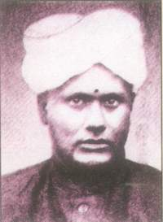
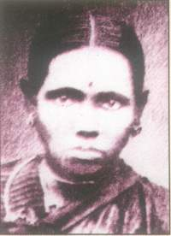
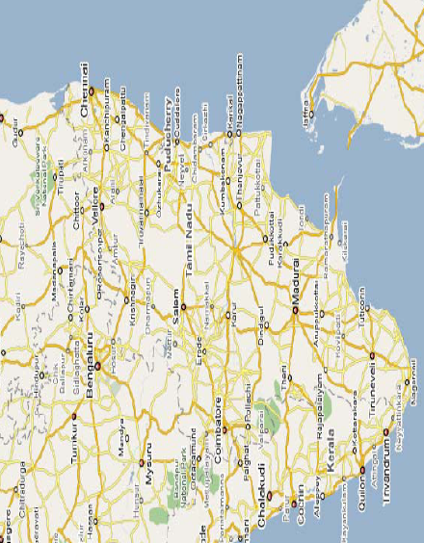
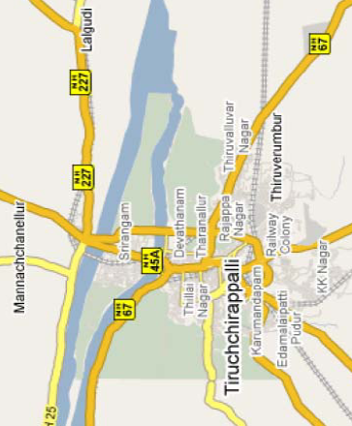
Born- 7th November 1888
to
R. Chandrasekhar Iyer
Parvathi Ammal

Slide 3
2nd in eight children (5 sons and 3 daughters)
Father teacher in a school, later moved to Visakhapatanam to be a lecturer in Mathematics and Physics in the Mrs AVN College when Raman was 3, with a salary of Rs 85/- per month
Matriculated at 11, FA at 13, BA at 15 from the Presidency College in Chennai (Gold medal in English and Physics) and MA at 18 (exempted from attending all classes of science)
First research paper at the age of 16 in The Philosophical Magazine (London) on diffraction of light from prism, and another on measurement of surface tension (communicated by author himself, with no acknowledgements!)
Topped Civil Services exam (Finance Dept)- “I shall ever be grateful to the Civil Surgeon of Madras”
In 1907, at 18 ½ married Lokasundari and then joined as Asst Accountant General in the Finance Dept, Kolkata

Slide 4
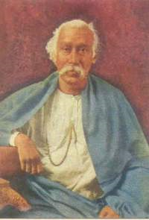
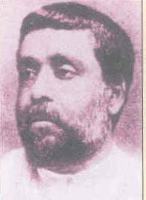
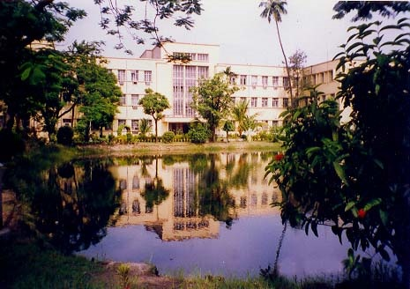
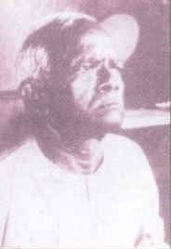
Amrit Lal Sircar- offered Raman place and instruments to work at Cultivation of Science
IACS, Kolkata
Mahendra Lal Sircar
“Younger men must come and step into my place and make this into a great institution”
Raman’s routine at Kolkata:
5:30 am, go to the Association
9:45 am, return home, bathe, breakfast in haste, leave for office
6:00 pm, go directly to the Association
10:00 pm, return home
Sundays, all day at the Association
Ashutosh Dey- Raman’s collaborator and Asst for ~25 years. Himself never went to any University!

Slide 5
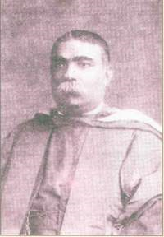
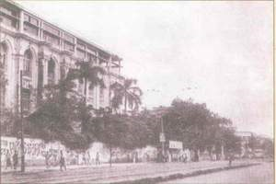
Science College, Kolkata
Asutosh Mookerji- offered Palit Professorship to Raman disregarding all norms. To the horror of some and amazement of all, Raman accepted Professorship at half of the salary
“In my case strangely enough it was not the love of science, nor the love of Nature, but an abstract idealization, the belief in the value of Human Spirit and the virtue of Human Endeavour and Achievement. When I read Edwin Arnold’s classic The Light of Asia, I was moved by the story of the Buddha’s great renunciation, of his search for truth, and of his final enlightenment. It showed me that the capacity for renunciation in the pursuit of exalted aims is the very sense of human greatness.”

Slide 6
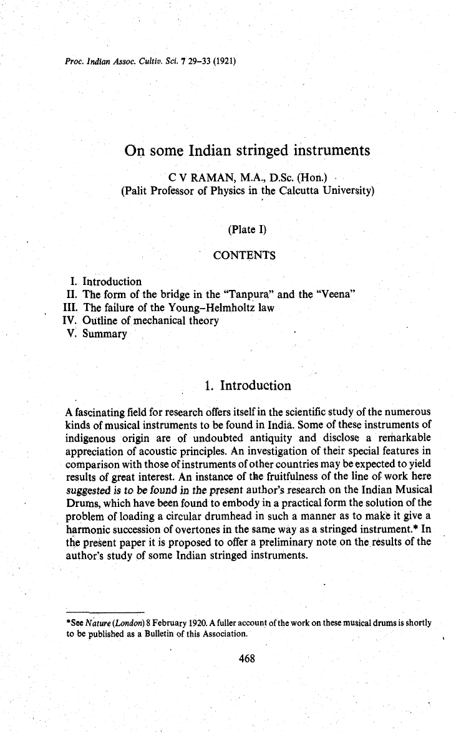
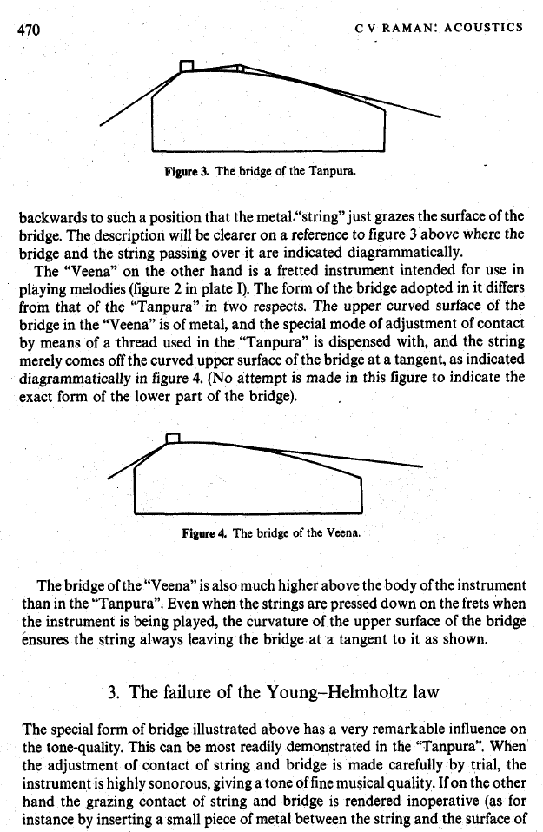
Early work 1907- 1917
Whether Indian instruments- Veena and Sitar produce good sound- is it a sentiment or has a physical quality ascribed?
Violation of Young-Helhmholtz law
They produce more harmonics than other instruments!

Slide 7
Preamble to Raman Effect
1921, Sir Ashutosh convinces Raman to undertake tour of Europe as a delegate of Universities’ congress
Raman meets Rutherford, Bragg and J. J. Thomson
During sight seeing tour of London, gets fascinated by St. Paul’s Cathedral and its whispering galleries: two papers, one in Nature and the other in Proceedings of the Royal Society
Awestruck by the grandeur of the Mediterranean sea, its beauty and blueness, the more he saw, the more did his wonder grow
Performed experiment on the ship by taking a Nicole prism and observing at Brewster’s angle. Demolished the theory that the blueness of sea is the reflection of blue of the sky.
Blueness of the sea must be from scattering by the water (Einstein-Smoluchowski formalism may be applied to molecular diffraction)

Slide 8
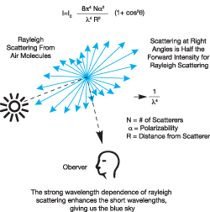
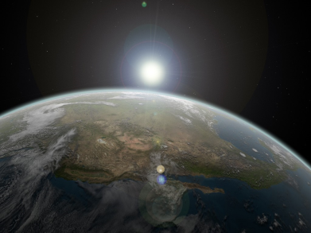
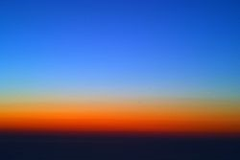
Rayleigh Scattering
Lord Rayleigh, Nobel Prize, 1904 for discovery of Argon
Particles much smaller than the wavelength of light
Scattering is elastic
Can occur is transparent solids and liquids, but most prominent in gases

Slide 9
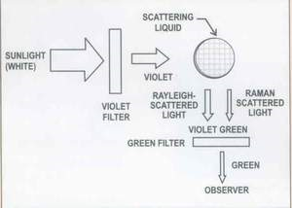
Preamble to Raman Effect
Began three lines of investigation upon return from England:
The scattering of light by liquids
The scattering of X-rays by liquids
The viscosity of liquids
1922- Molecular diffraction of light: What would happen in a black body enclosure if the exchange of energy took place by molecular scattering? How energy could be transferred between quantum of light and molecules?
1923- Theory of viscosity
1293- Scattering of Sun light by water (not because of weak fluorescence)
At a very early stage in our investigations, we came across a new and entirely unexpected phenomenon. As early as 1923, it was noticed that when sunlight filtered through a violet glass passes through certain liquids and solids e.g., water or ice, the scattered rays emerging from the track of the incident beam through the substance contained certain rays not present in the incident beam. The observations were made with colour filters (see Figure 1). A green glass filter was used which cut off all light if placed between the violet filter and the substance. On transferring the glass to a place between the substance and the observers eye, the track continued to be visible though feebly. This is a clear proof of a real transformation of light from a violet into a green ray. The most careful chemical purification of the substance failed to eliminate the phenomenon. -C.V.Raman in Presidential Address to the Indian Science Congress 1929.

Slide 10

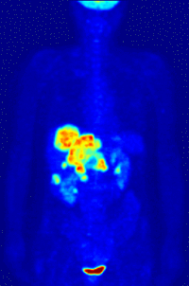
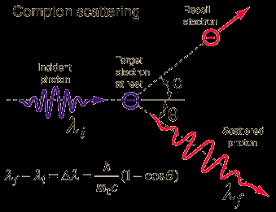
H. Compton
Nobel Prize 1927 for discovery of Compton Effect
PET scan showing Compton scattering of γ-rays

Slide 11
Preamble to Raman Effect
1927- Vacation to Waltair- true Compton scattering cannot be observed at optical wavelengths
January 1928- Venkateswaran observes that glycerine scatters light in green range
Last week of January 1928- Raman urges K. S. Krishnan to take up experimental work and follow up Venkateswaran’s observations (“it was not healthy for a scientific man to get out of touch with actual experimentation for any length of time”)
7th February 1928- K. S. Krishnan observes with a 7 inch lens that all his liquids exhibit the famous “weak fluorescence” of Ramanathan and that the polarisation of the “fluorescent” light is greater the smaller the anisotropy of the molecule. Raman confirms that these observations are related to Kramers- Heisenberg process that they had been pursuing.

Slide 12
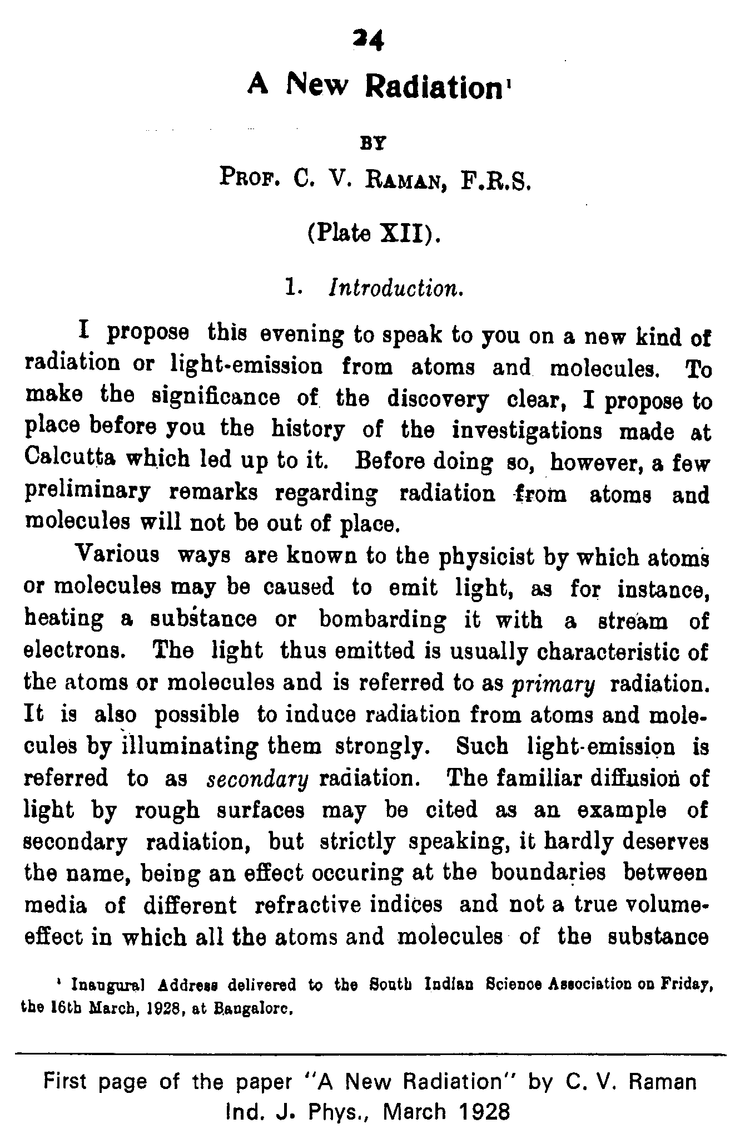
The Raman Effect
16th February 1928- Post a note to Nature “the modified radiation could arise from the fluctuations of the molecules from the normal state”
27th February 1928- Raman decides to view the “fluorescence track” through a direct vision spectroscope, but by the time Ashu Babu sets it up, Sun has set ☹
28th February 1928- Spectroscope shows that the track contains not only the incident colour but at least another separated by a dark space.
29th February- Discovery is announced to the Associated Press
8th March, Note sent to Nature by Raman and Krishnan is rejected by a referee, but published by the Editor!
Cable to Nature from R W Wood: “Prof. Raman’s brilliant and surprising discovery;I have verified his discovery in every particular. Raman’s discovery thus makes it possible to investigate remote infrared regions hitherto little explored. It appears to me that this very beautiful discovery which resulted from Raman’s long and patient study of the phenomenon of light scattering is one of the most convincing proofs of the quantum theory of light”

Slide 13
The initial paragraph of the historic paper of Raman and Krishnan announcing the discovery of the Raman effect, which appeared in Nature (C. V. Raman and K.S. Krishnan, Nature, 121(3048), 501, March 31,1928)
A New Type of Secondary Radiation
If we assume that the X-ray scattering of the unmodified type observed by Prof.Compton corresponds to the normal or average state of the atoms and molecules, while the modified scattering of altered wavelength corresponds to their fluctuations from that state, it would follow that we should expect also in the case of ordinary light two types of scattering, one determined by the normal optical properties of the atoms or molecules, and another representing the effect of their fluctuations from their normal state. It accordingly becomes necessary to test whether this is actually the case. The experiments we have made have confirmed this anticipation, and showed that in every case in which light is scattered by the molecules in dust-free liquids or gases, the diffuse radiation of the ordinary kind, having the same wavelength as the incident beam, is accompanied by a modified scattered radiation of degraded frequency.
The new type of light scattering discovered by us naturally requires very powerful illumination for its observation. In our experiments, a beam of sunlight was converged successively by a telescope objective of 18 cm. aperture and 230 cm. focal length, and by a second lens was placed the scattering material, which is either a liquid (carefully purified by repeated distillation in vacuo) or its dust free vapour. To detect the presence of a modified scattered radiation, the method of complementary light filters was used. A blue-violet filter, when coupled with a yellow-green filter and placed in the incident light, completely extinguished the track of the light through the liquid or vapour. The reappearance of the track when the yellow filter is transferred to a place between it and the observers eye is proof of the existence of a modified scattered radiation. Spectroscopic confirmation is also available.
Some sixty different common liquids have been examined in this way, and everyone of them showed the effect in greater or lesser degree. That the effect is a true scattering, and secondly by its polarization, which is in many cases quite strong and comparable with the polarisation of the ordinary scattering. The investigation is naturally much more difficult in the case of gases and vapour, owing to the excessive feebleness of the effect. Nevertheless when the vapours is of sufficient density, for example with ether or amylene, the modified scattering is readily demonstrable.

Slide 14
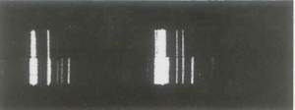
Nobel Prize, 1930 in Physics for “on the diffusion of light and for the discovery of the effect named after him”
Thanks to the vastly more powerful illumination made available by the 7-inch refractor, the spectroscopic examination of the effect, which had been abandoned in 1925 as indecisive, now came within the reach of direct visual study. With a Zeiss cobalt glass filter placed in the path of the incident beam and one or other of a series of organic liquid as the scattering substance, a band in the blue-green region was observed by me in the spectrum of the scattered light, separated by a dark interval from the indigo-violet region transmitted by the filter. Both of these regions in the spectrum became sharper when the region of transmission was narrowed by the insertion of an additional filter in the incident beam. This suggested the employment, instead of sunlight, of the highly monochromatic radiations given by a mercury arc in combination with a condenser of large aperture and a cobalt glass filter. With these arrangements the spectrum of the scattered light from a variety of liquids and solids was visually examined, and the starting observation was made that the spectrum generally included a number of sharp lines or bands on a diffuse background which were not present in the light of the mercury arc.

Slide 15
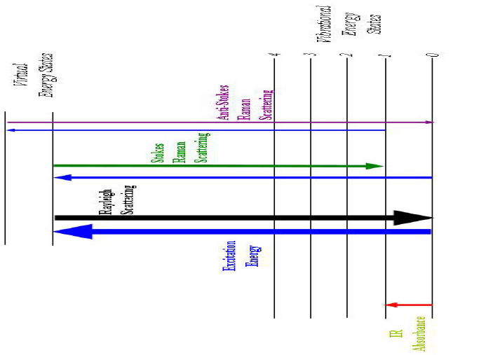

Slide 16
“When the Nobel award was announced I saw it as a personal triumph, an achievement for me and my collaborators -- a recognition for a very remarkable discovery, for reaching the goal I had pursued for 7 years. But when I sat in that crowded hall and I saw the sea of western faces surrounding me, and I, the only Indian, in my turban and closed coat, it dawned on me that I was really representing my people and my country. I felt truly humble when I received the Prize from King Gustav; it was a moment of great emotion but I could restrain myself. Then I turned round and saw the British Union Jack under which I had been sitting and it was then that I realised that my poor country, India, did not even have a flag of her own - and it was this that triggered off my complete breakdown.”
Toast during Nobel function, 1930:
“Sir you have seen the Raman Effect on alcohols, please do not try to see the alcohol effect on Raman”

Slide 17
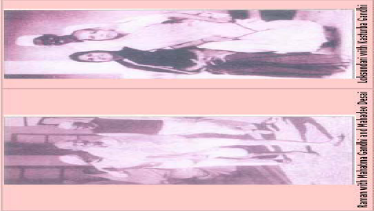

Slide 18
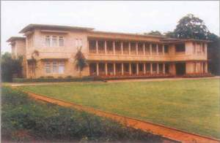

Raman Research Institute
21-Nov-1970

